Slide 1
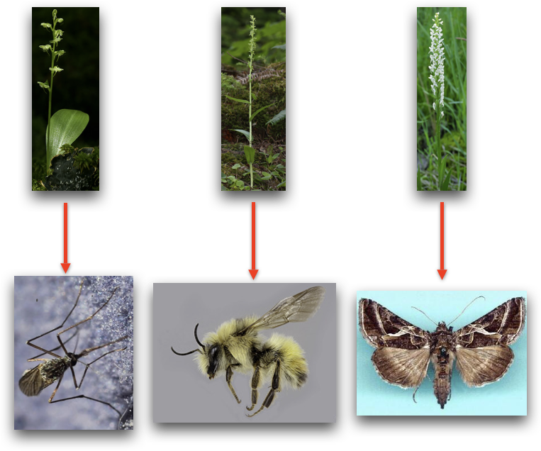
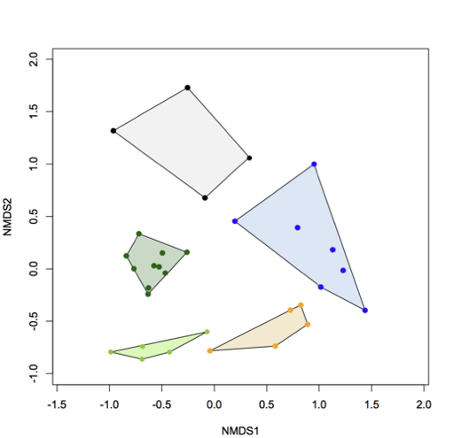
Figure 1: Aedes mosquito (♂) on P. obtusata with pollinia
Figure 2: NMDS of Platanthera floral scent; stress = 3; Black – P. stricta; Blue – P. dilatata; Orange – P. huronensis; Greens – P. obtusata

